Slide 1
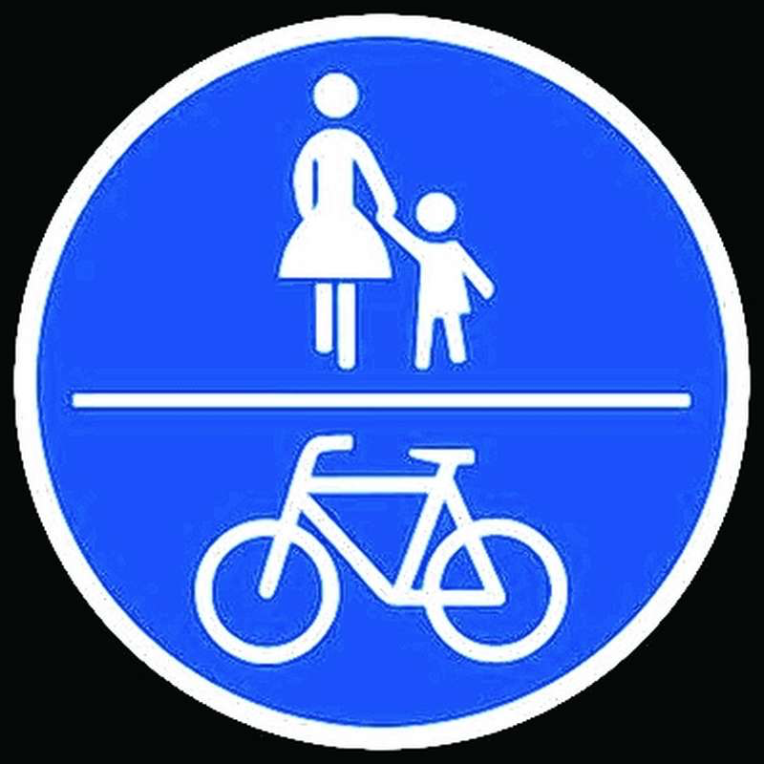
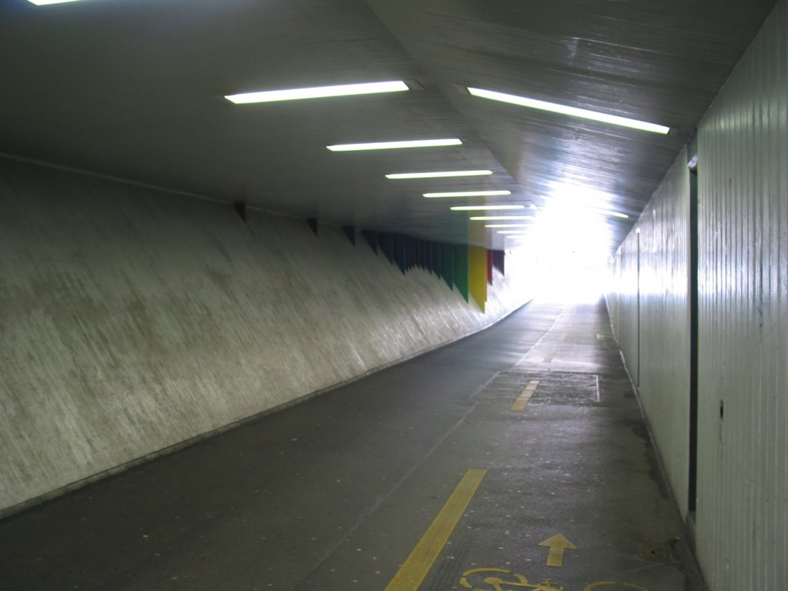
Modelling the interaction of pedestrians and bikers
We love cycling
Every day experience
Social Force Model
Capacity and Security
Bicycle bell
Bikeswarms
Sandro Giacomuzzi - Hannes Heller – Manuel Holzer

Slide 2
Reasearch Questions
Social Force Model for simulating bikers?
Effects of traffic separation by road marking?
Capacity
Security
Notes:
Is social force adequate?

Slide 3
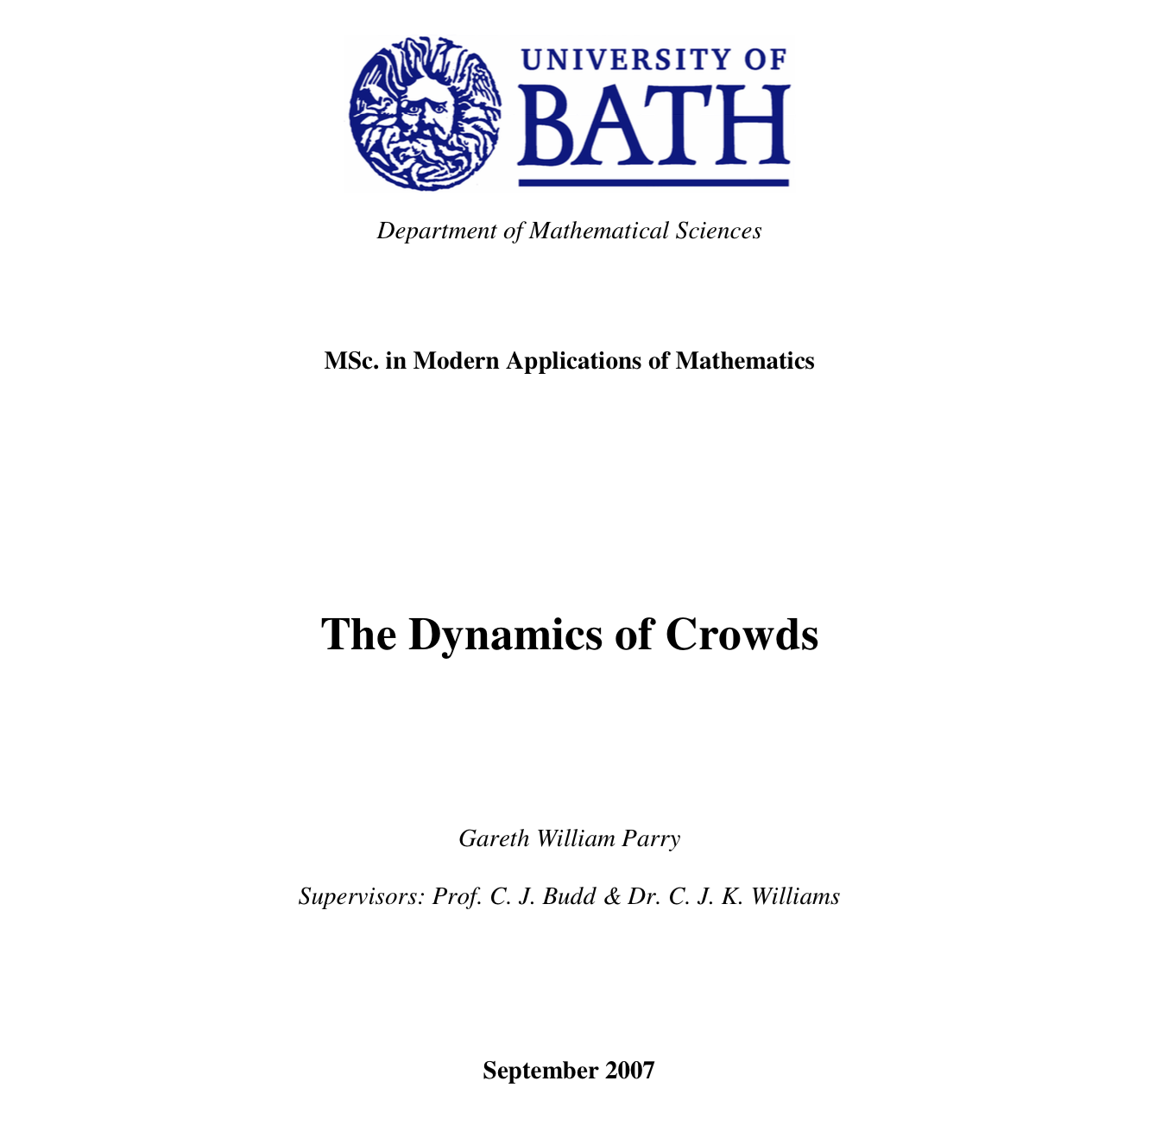

Slide 4

Notes:
What‘s the problem?

Slide 5
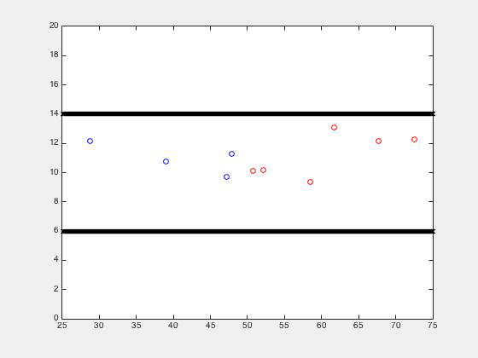
Notes:
Nicer colors

Slide 6
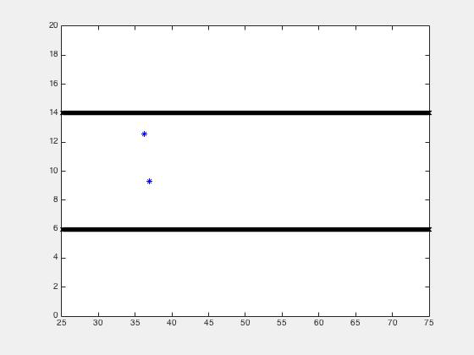

Slide 7
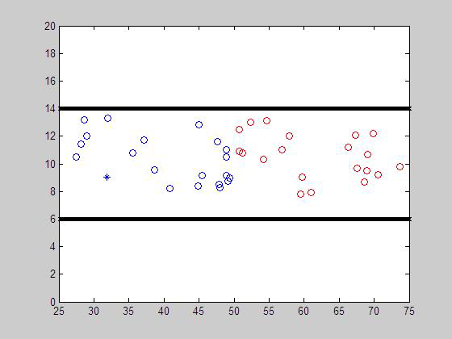

Slide 8
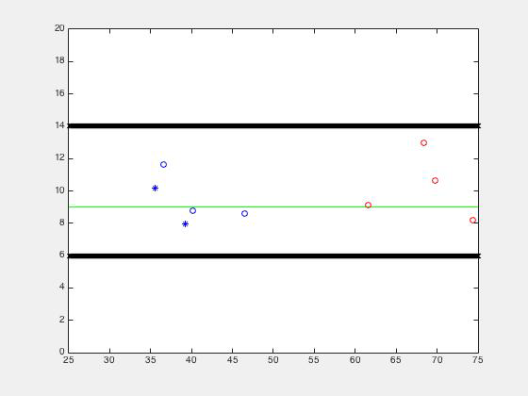

Slide 9
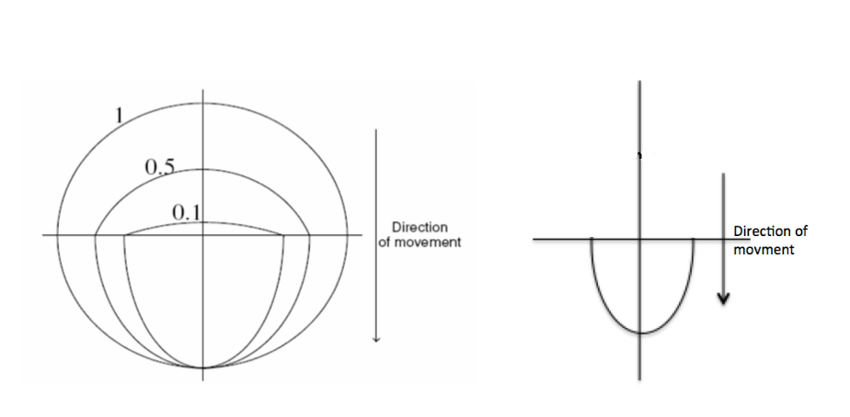
Modelling of bikers

Slide 10
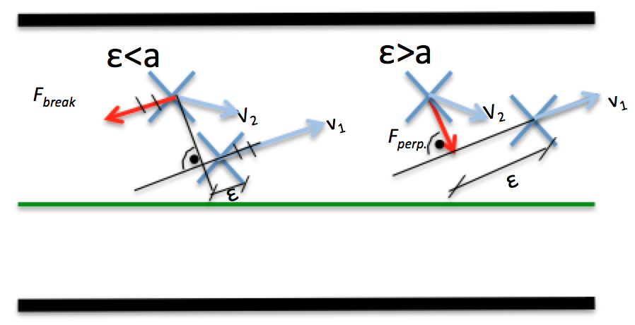
Slipstream Force

Slide 11
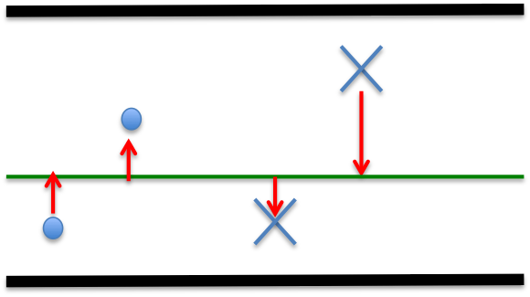
Bikelane

Slide 12
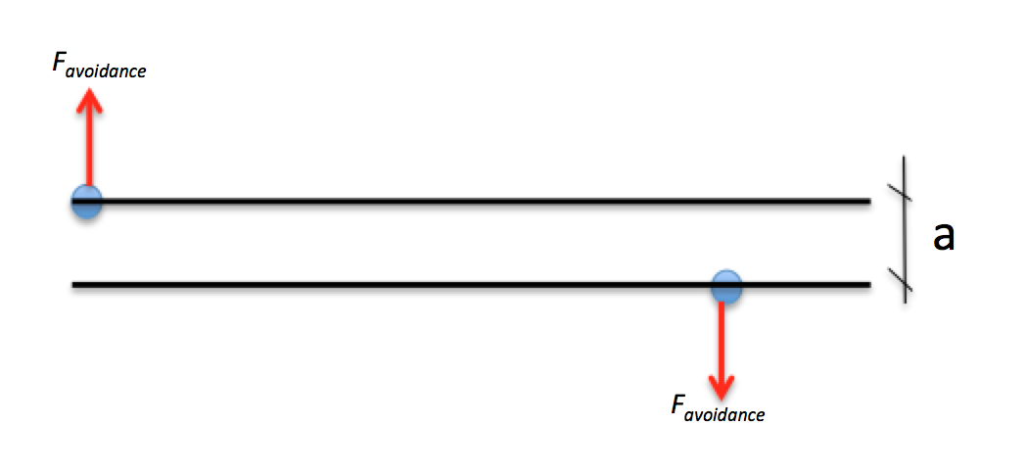
Avoidance

Slide 13
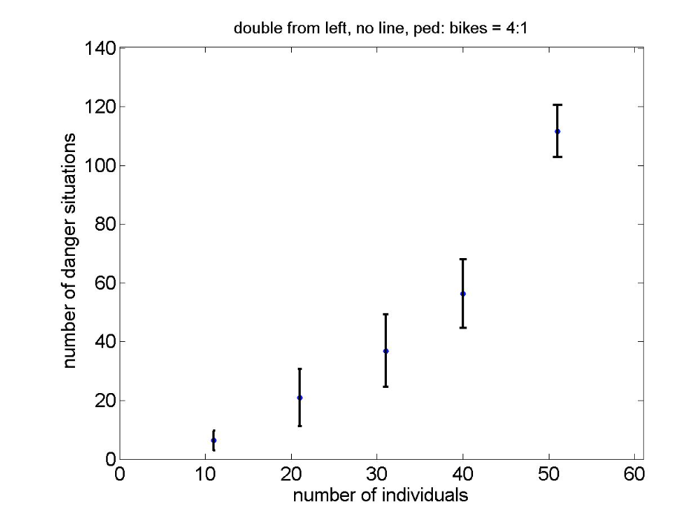
Statistics

Slide 14
